Slide 1
Contractor Platform
Presented by Ahmed Ali
May 12, 2025

Slide 2

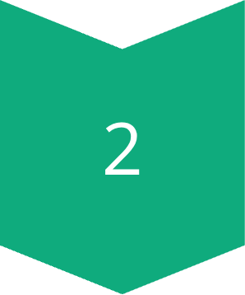
The Problem
Clients struggle to find reliable contractors. Contractors can't easily find projects matching their skills/location.
The Solution
A platform connecting clients with qualified contractors via smart matching.
Key Differentiators
Clean Workflow
Free Contractor Trial
Ratings System
Admin Dashboard

Slide 3
Platform Overview
Main Screens (Wireframe Summary)
User Journey: Client
Homepage: Client/Contractor Join
01
Login/Sign-Up
Sign Up
Client Dashboard: Project Posting, Bid Viewing
Contractor Dashboard: Matching Projects, Bid Submission
02
Messaging: Simple Chat
Post Project
03
Receive Bids
04
View Profiles
05
Chat & Select
User Journey: Contractor
01
02
03
Sign Up
Add Specialty & Work Area
View Matching Projects
04
05
Send Bid
Chat with Client

Slide 4
User Roles & Key Features
End Users
Feature Benefits
Client: Posts projects, selects contractors.
Contractor: Views projects, submits bids.
Client
Admin: Manages users, content, subscriptions.
Finds the right contractor faster.
Key Features
Project Posting
Contractor
Contractor Profiles
Accesses suitable job opportunities.
Messaging
Ratings
Admin
Admin Dashboard
Manages platform operations with ease.

Slide 5

Technology Stack
Programming Languages
Frameworks & Technologies
C#
ASP.NET MVC
HTML
Entity Framework
CSS
Microsoft SQL Server
JavaScript (Native)
.NET Runtime
Native Front-End (HTML/CSS/JS)
Backend built with ASP.NET MVC + EF. Frontend kept lightweight and simple for optimal performance.

Slide 6
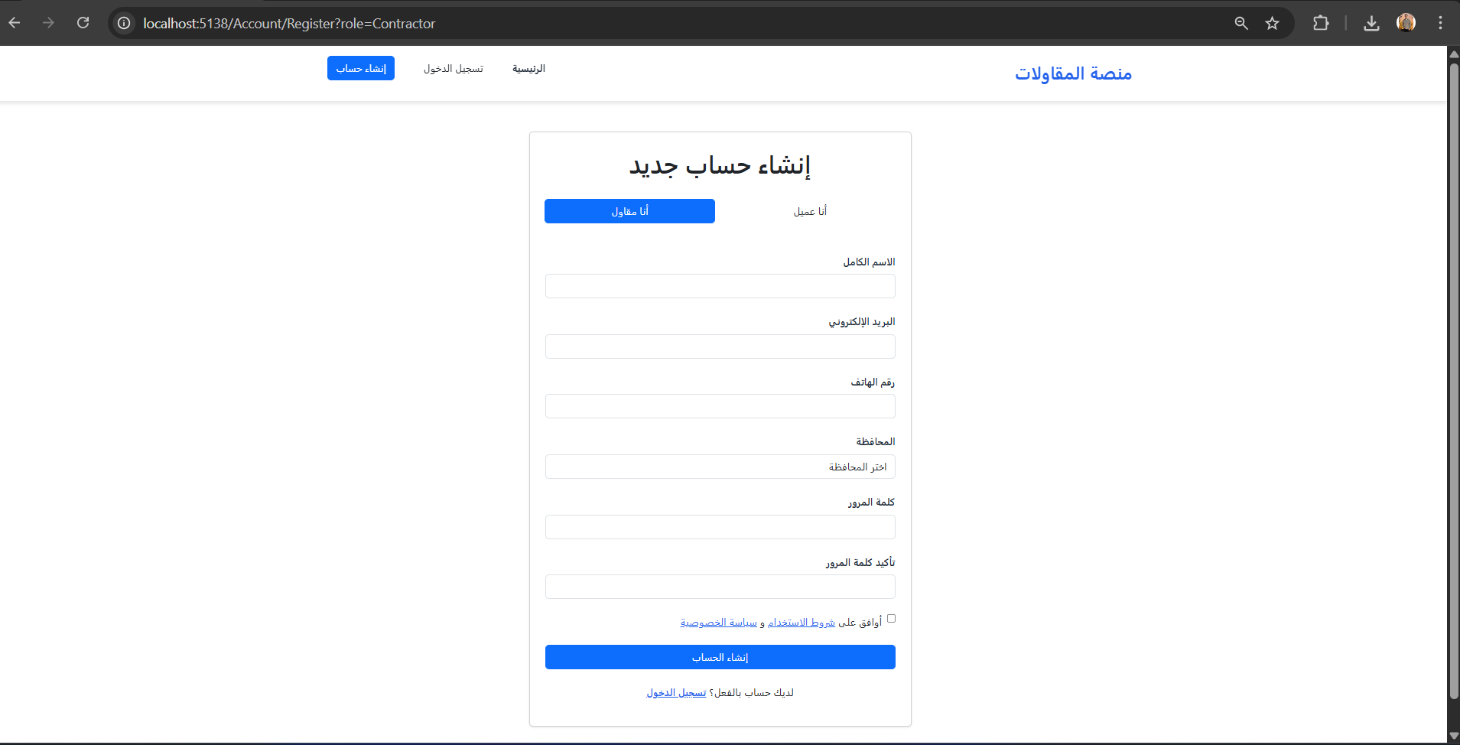

Slide 7
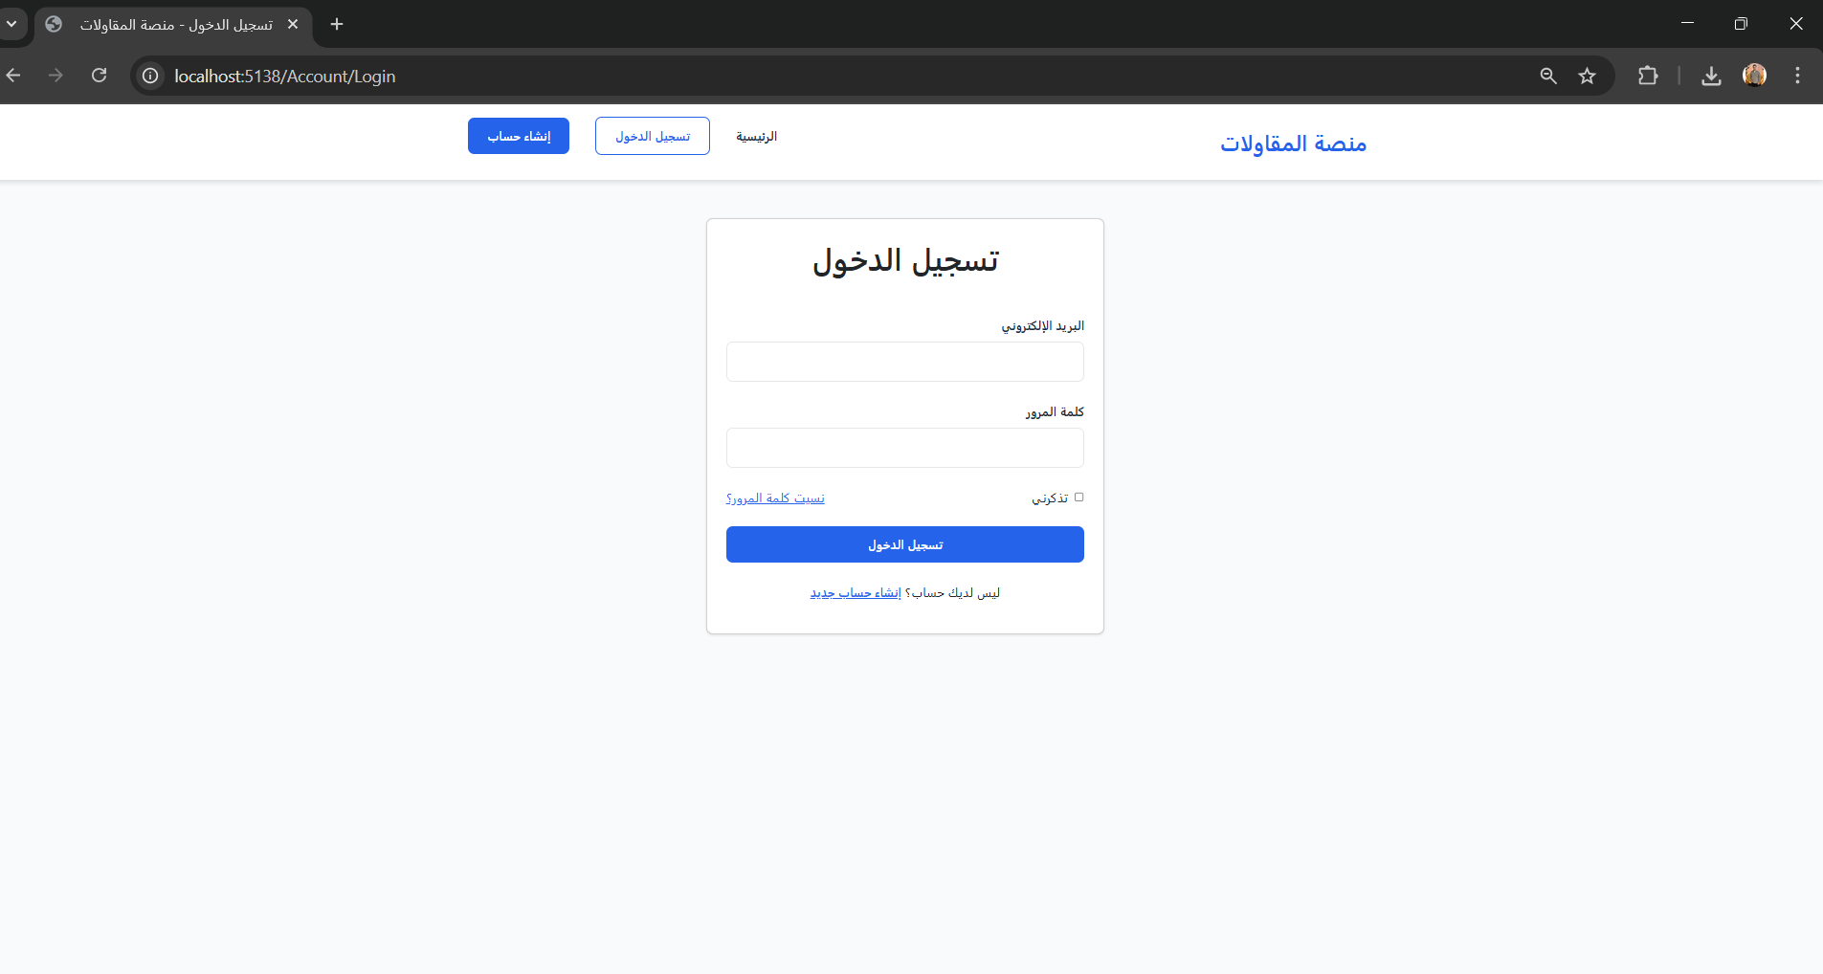

Slide 8
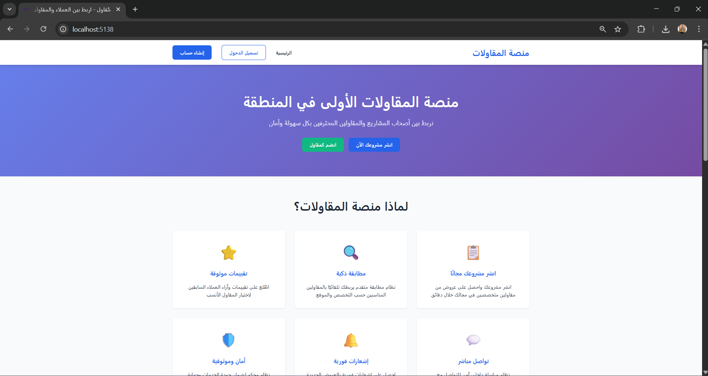

Slide 9
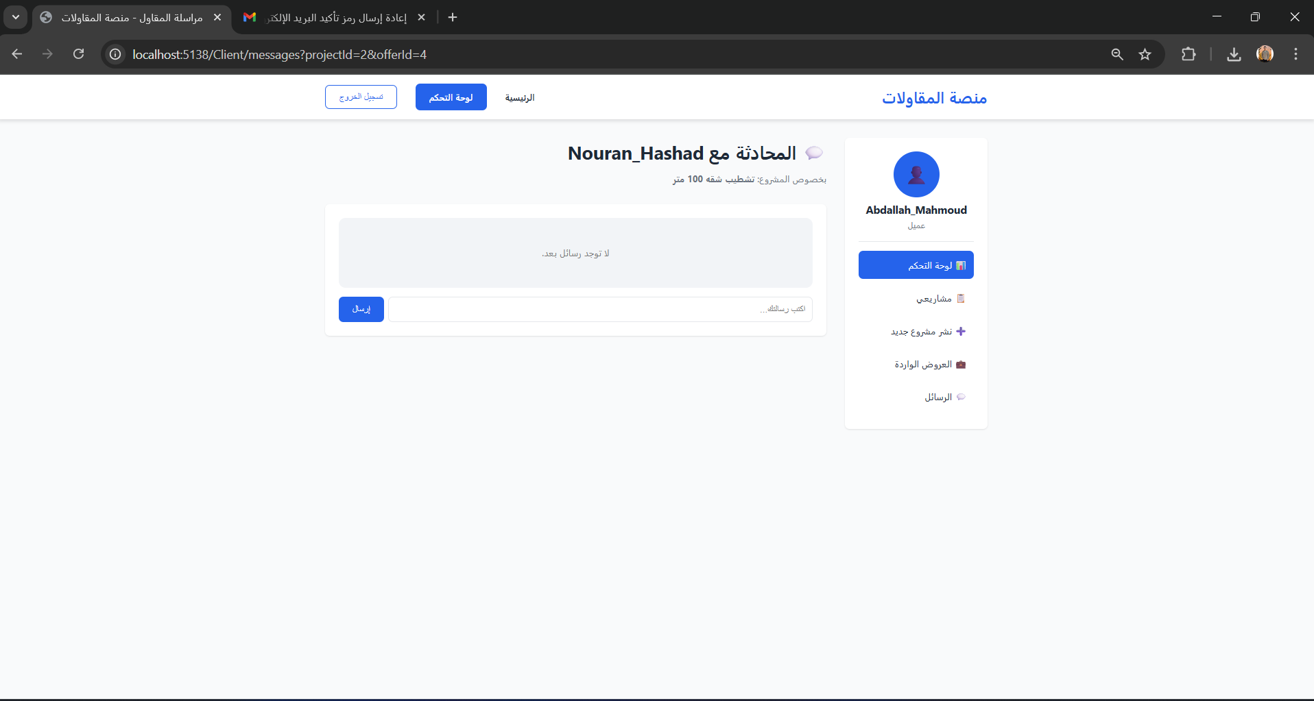
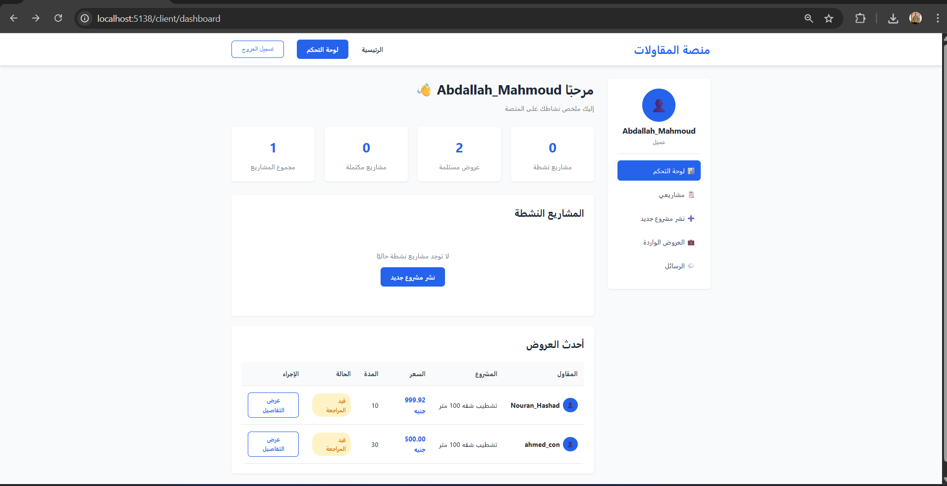

Slide 10
